Slide 1

The ever expanding universe
By Khushiv shah
Notes:
the ever expanding universe

Slide 2

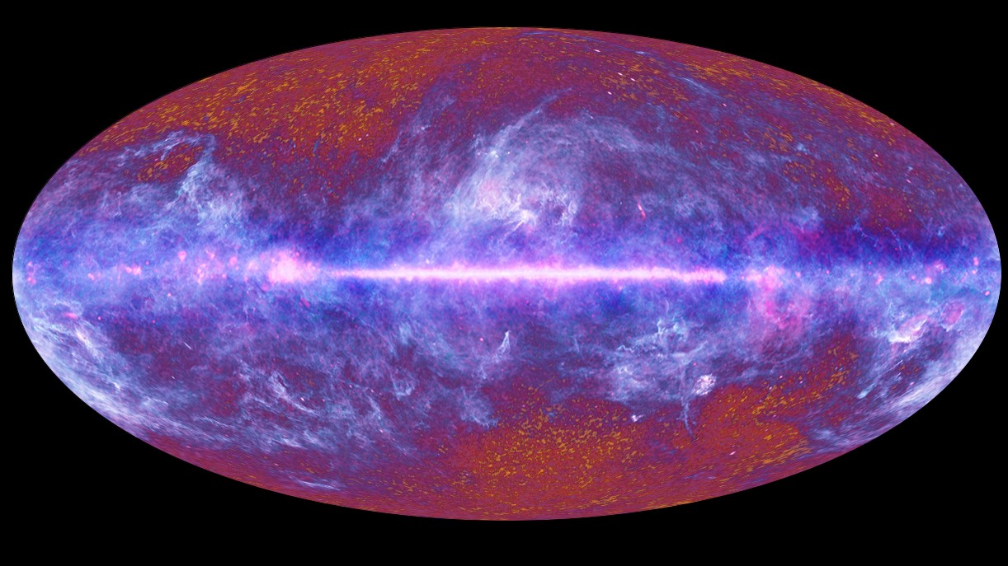
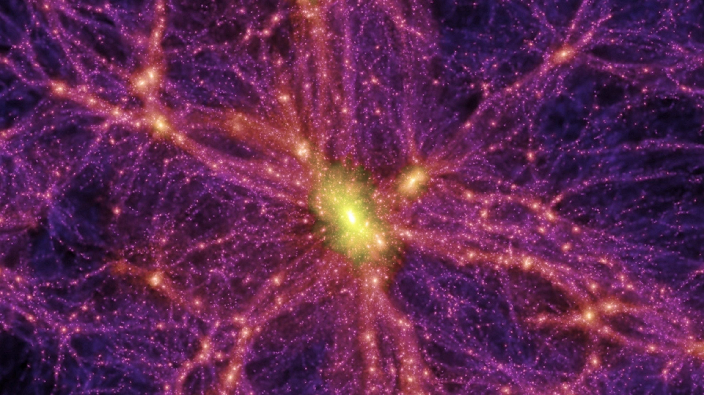
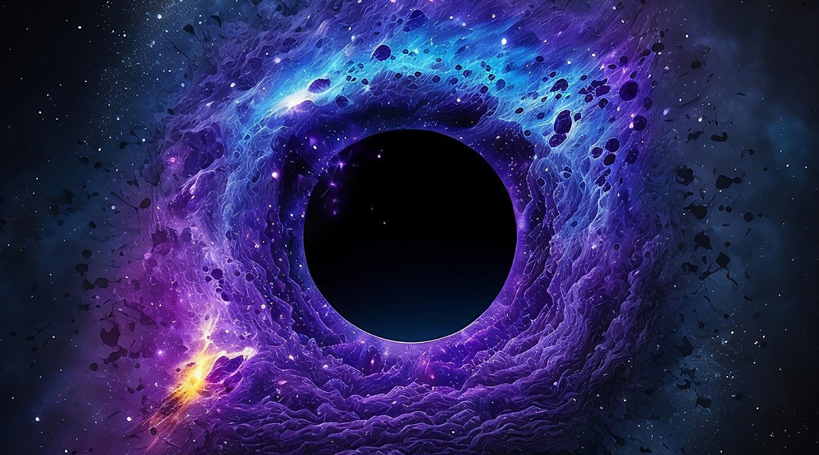
evidence
The red shift
Dark matter
Cosmic background radiation
Notes:
Redshift is when light from something far away, like a star or galaxy, looks stretched out and turns red because it’s moving away from us, like the sound of a siren getting lower as it moves away.
Dark matter is stuff we can’t see, but it helps keep galaxies together, kind of like invisible glue holding everything in place.
The CMB (Cosmic Microwave Background) is the faint glow of light that fills the universe, which was created shortly after the Big Bang, like an ancient echo of the universe’s very first light, and it helps scientists understand how the universe began.

Slide 3

questions
Big freeze?
What is dark energy?
Big rip?
Big crunch?
Notes:
this raises possible questions about our future and the end of the universe and how it would

Slide 4

ENDLESS POSSIBILITES and answers
How does the universe work
What was before the universe
Endless cosmology practicals
Notes:
these questions sparks interests in curious minds which would allow us to understand

